Slide 1
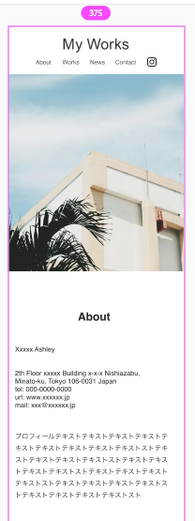
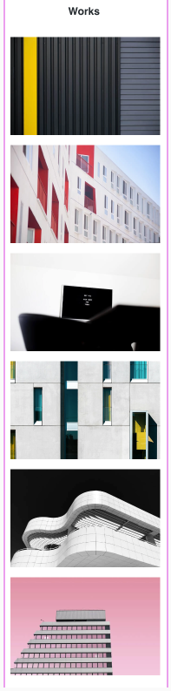
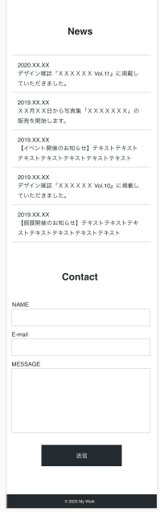
header
Section id works
Section id news
main
<H2> class
Section title
センター
#flex
header
class logo flex
<a><img>
<H2>
class section title
<h1>
img/logo.svg
main
Text-align: center;
Nav class flex
Div class work column img
<ul>
#flex_header ul li {
display: inline-block;
}
List 1
Instagram
Div icon
<dt>
<li><img>
<dd>
main
Div class mainVisual
<dt>
Div class work column img
<dl>
<dd>
Ul
flex
wrap
class
Works column
<dt>
List 3
<img>
mainvisual-pc.jpg
mainvisual-sp.jpg
@media screen display: none
Div class
news
<li><img>
<dd>
<dt>
<li><img>
<dd>
<dt>
Div class work column img
センター
<dd>
Section
Id about
Div class work column img
Section
id contact
センター
<H2> class section title
センター
<H2>
class section title
<li><img>
<form>
<p>
Div class contact
form
レフト
Div class work column img
<form>
<ul>
List 2
レフト
<li><img>
<form>
Div class form text flex
<p>
Div class work column img
Div class form button
<form>
レフト
<li><img>
footer
<p>
センター
Div class footer

Slide 2
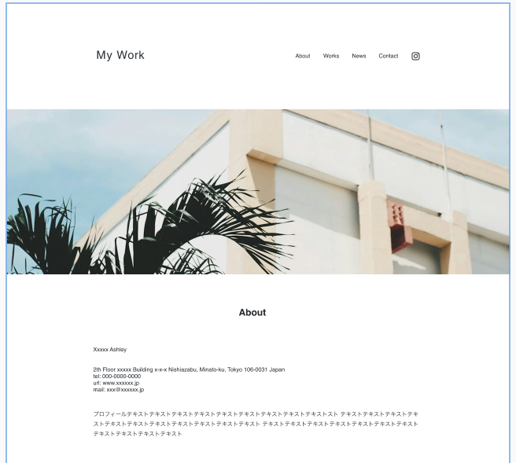
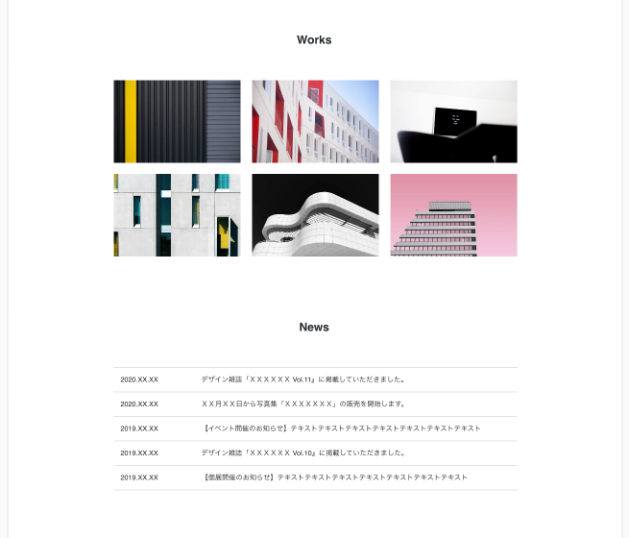
header
#flex header
Section id works
<H2> class
Section title
<h1>
logo
Nav class flex
Instagram
Div icon
List 1
Div class work column img
main
Div class mainVisual
Main img
Ul
flex
wrap
Works column
<img>
<img>
<img>
<img>
<img>
<img>
<img>
Div class name
<H2> class
Section title
Section id news
<H2> classSection title
<h3>
<dt>
センター
<dd>
Div class
mydata
<dl>
List 2
Div class
news
List 3
Div class profile
<p>
Section
Id about

Slide 3
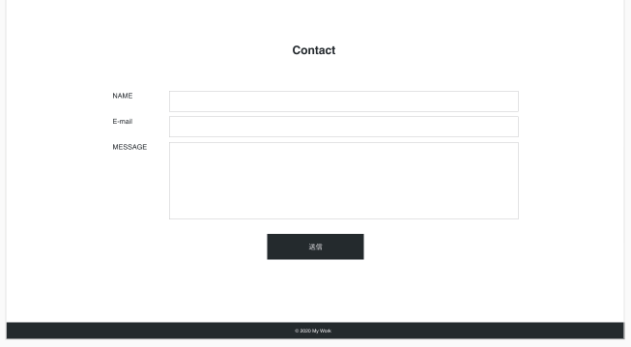
main
Section
id contact
<form>
<H2>
class section title
<form>
<form>
Div class form text flex
Div class contact
form
Div class form button
<form>
footer

